Slide 1
Predicting the retail customer retention potential level as high/medium/low and customer segmentation and pattern extraction.
Tetali Ram subba reddy-4751

Slide 2
Business Problem
The problem we are trying to solve is predicting the level of customer retention potential for retail businesses.This involves customers who are likely to stay with business in long term,at which ones are at risk of leaving.We also want to segment customers on the basis of their transactions,email behaviour and preferences,and extract patterns that can help us understand what drives customers loyalty and retention.
It is important for any retail company to focus on customer through continuous engagement which translates to increases sales and resultant profitability measured over a period.The customer churn results in not just loss of potential revenue and future profits together with sunk acquisition costs but also negative publicity and incurrence of additional cost of new acquisitions.

Slide 3
ML problem Statement.
For this problem statement our main aim is to classify customers as high/medium/low under the column ‘Retention-potential’.
It is a classification problem which comes under supervised learning and another part of the problem statement involves customer segmentation which comes under unsupervised learning.
We will use different classification algorithms based upon the results we get from the learning curves.We will choose a best model which generalize well the the unseen data.
We will observe our model performance by various error metrics,here according to our problem statement recall for medium customers is most important so we will try different models such that we get best recall score.

Slide 4
Analytical approach
For understanding retention potential of a particular customer,firstly we should understand his transactions?How frequent is his transactions?What are the average number of orders he place in a period of time?When was his last transaction?From how many years he has been our customer?IS he still Intrested in our businesses?How can we attract customer again?What kind of promotional offers we can bring such that we can gain him?her back?
How effective our email campaigns are?How are sales every year?what is trend of orders which are getting placed w.r.t to email campaigns done?

Slide 5
Steps in data exploration
1)Data collection
2)Data cleaning
3)Data visualization
4)Descriptive statistics
5)Correlation analysis
6)Removal of redundant columns

Slide 6
Data exploration
We are provided with four datasets and we have to merge them to get comprehensive analysis so we will merge them to understand customer behaviour more effectively and understand customer from wider perspectives.
Our datasets consists of 23820 unique customers ids whom we have to classify under the column retention potential.While merging by using different dates of a particular customer,few new columns have been generated such that it would be more impactful for our analysis.
So after combining all the merged files we are having 41 columns, which need to be further analysed such that we get proper understanding our our data.What kind of features should be kept ?what features are important?

Slide 7
Merging of datasets
We merged datasets based upon the common column customer id using pd.merge from pandas library.
train=customer.merge(train, on="CustomerID").merge(mail_data, on="CustomerID").merge(transaction_data, on="CustomerID").merge(mail_open_counts, on="CustomerID").merge(MailClicked_counts, on="CustomerID")
We had used inner join here which combines all the common rows from a column which we had chosen while joining our datasets.

Slide 8
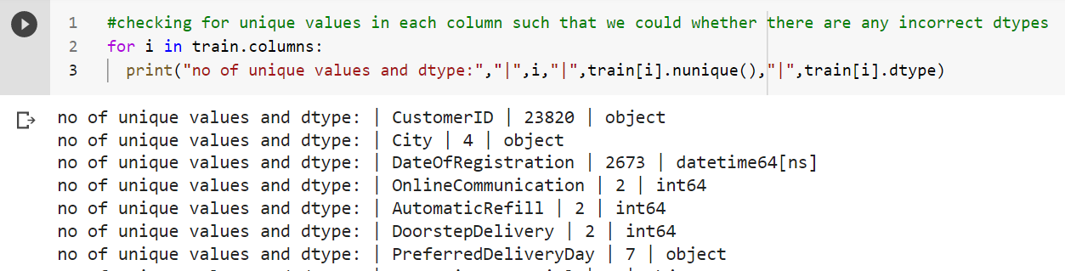
Data structure and content
It is a snapshot of few columns in our dataset showing unique values of that column and datatype of column.Based upon unique values, datatype we can identify incorrect datatype and correct them before going in to our model building part.
#converting dtypes of the following columns
train["OnlineCommunication"]=train["OnlineCommunication"].astype("object")
train["DoorstepDelivery"]=train["DoorstepDelivery"].astype("object")
train["AutomaticRefill"]=train["AutomaticRefill"].astype("object"

Slide 9
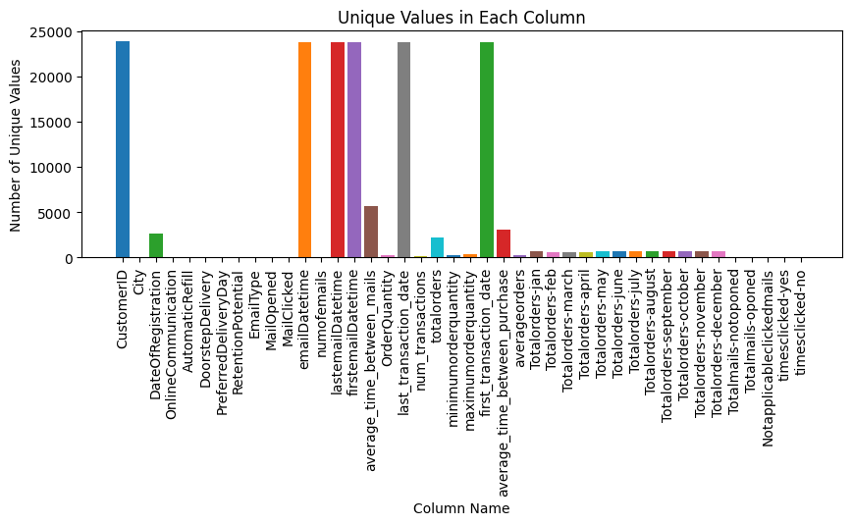
No of unique values present in each column of our dataset.

Slide 10
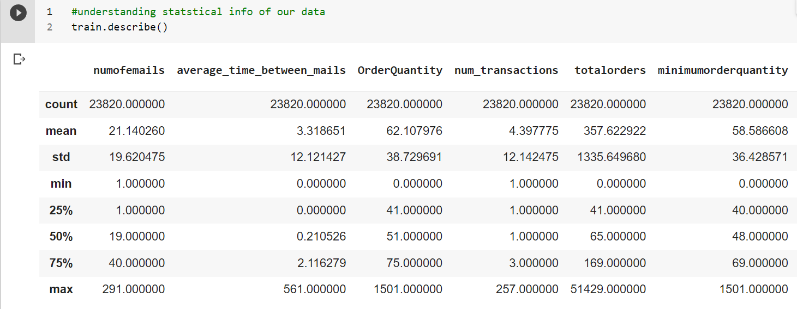
Descriptive analysis
w
w

Slide 11
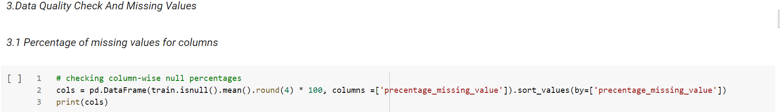
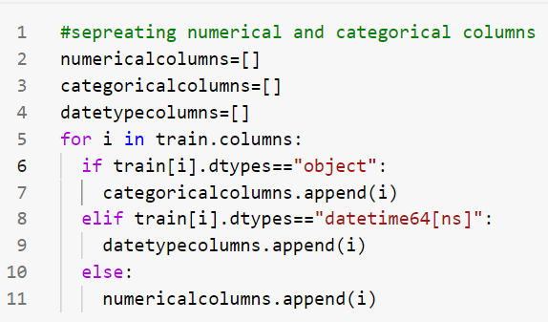
From this codes above we can see that we had separated categorical,numerical,datetype columns and now we are going to get description about percentage of missing values in this columns,hence we find out that there are no missing values present.

Slide 12
Generating new set of features
train["days_since_first_transaction"]=(train['last_transaction_date'] - train['first_transaction_date']).dt.days
train["email_duration"]=(train['lastemailDatetime']- train['firstemailDatetime']).dt.days
train["duration_of_customer_relation"]=(train['last_transaction_date'] - train['DateOfRegistration']).dt.days
train["recency"]=(train["last_transaction_date"].max()-train["last_transaction_date"]).dt.daystrain["Totalorderquantity_in_first_quarter"]=train["Totalorders-jan"]+train["Totalorders-feb"]+train["Totalorders-march"]++train["Totalorders-april"]
train["Totalorderquantity_in_second_quarter"]=train["Totalorders-may"]+train["Totalorders-june"]+train["Totalorders-july"]++train["Totalorders-august"]
train["Totalorderquantity_in_Third_quarter"]=train["Totalorders-december"]+train["Totalorders-september"]+train["Totalorders-october"]++train["Totalorders-november"]

Slide 13
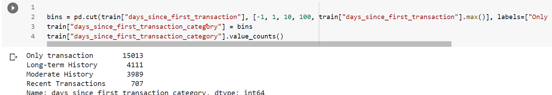
Binning of columns
We had binned a column days since first transaction into four categories such as only transaction,long term history,moderate history,recent transactions. To reduce sparsity in our columns as sometimes continuous columns are not able to predict our data much well.

Slide 14
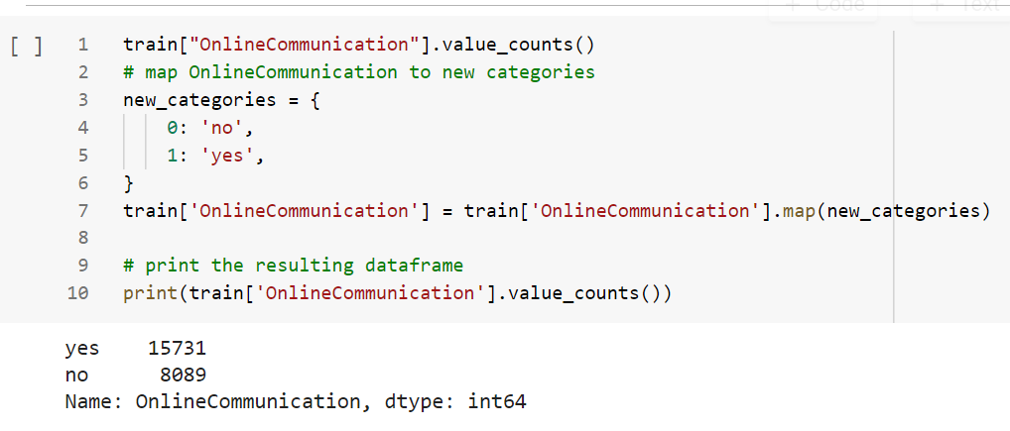
Mapping of columns
So,here is a sample of mapping online communication to yes or no,similarly for preferred delivery day and few other columns.

Slide 15
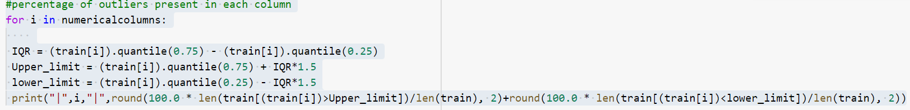
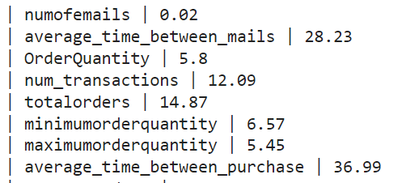
Outlier treatment
Outlier treatment for any data is quite important and essential and hence we need to check percentage of outliers in all of our columns.

Slide 16
Visualizations
In next few slides ,different visualizations are displayed from our dataset.
1)Visualizing sales trends,emails sent year wise and month wise
2)Analysis of customers city wise
3)Analysis of email duration category w.r.t mail opined
4)How minimum/maximum orders of a customer affect customer behaviour
5)Visualizations with respect to target variable
6)Interaction of customers with respect to company and their purchase behaviour

Slide 17
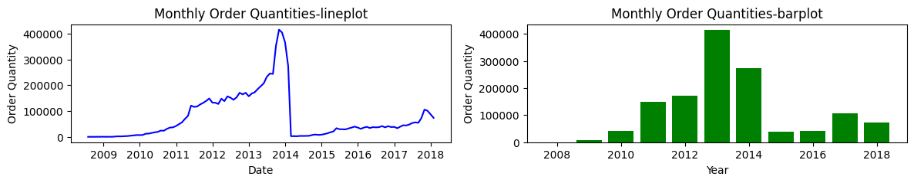
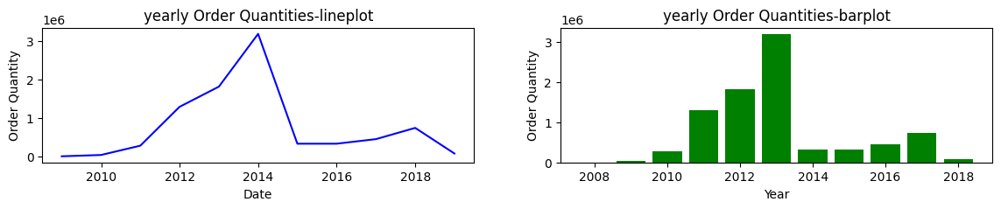
Line plot,Bar plot of order quantities with respect to month,year

Slide 18
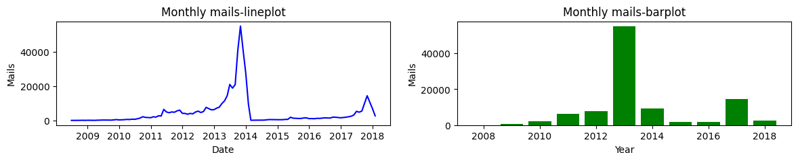
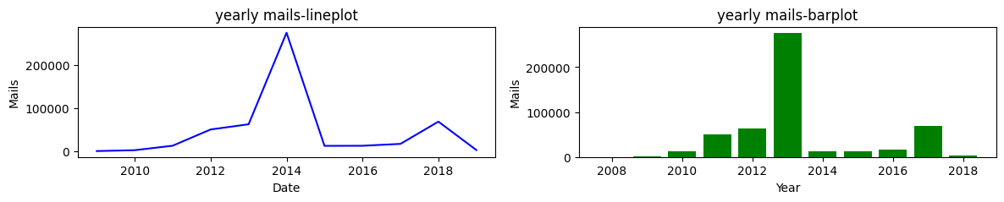
Line plot,Bar plot of Email with respect to month,year

Slide 19
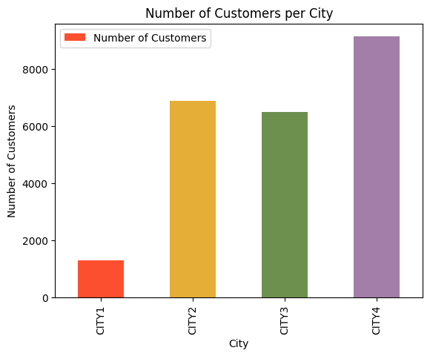
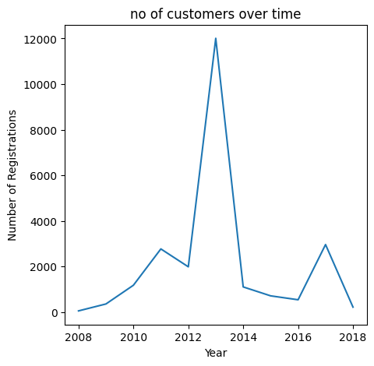
Customers from different cities.
Customer Acquistion over time

Slide 20
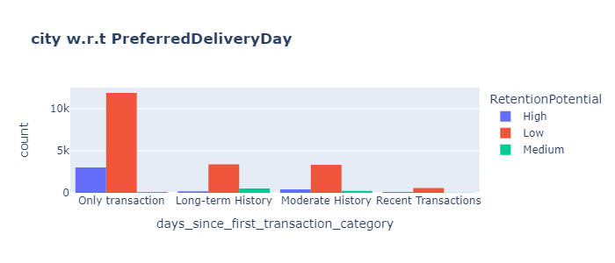
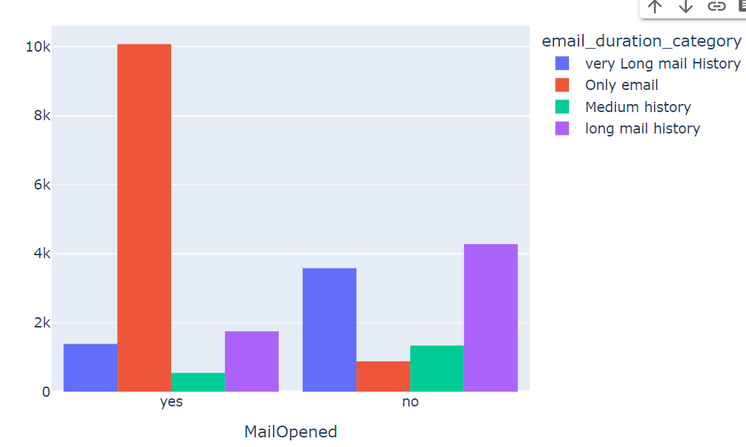
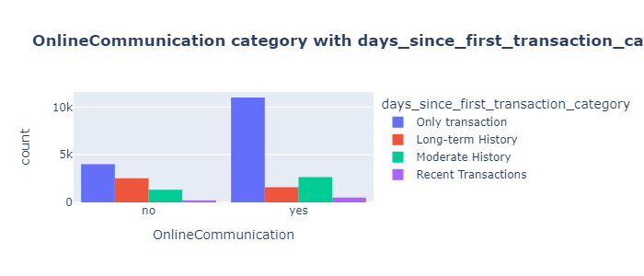
sss

Slide 21
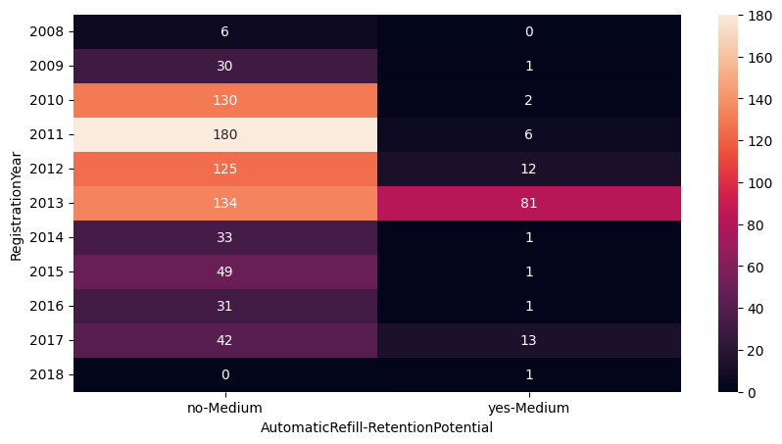
Year wise customer preference of automatic refill

Slide 22
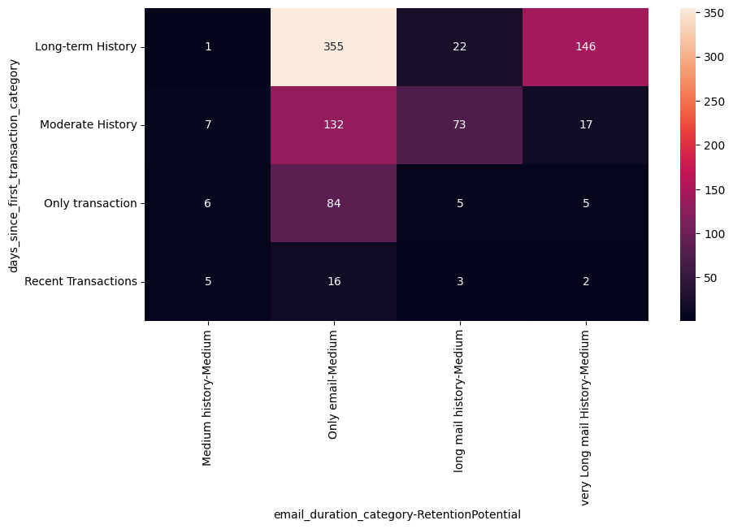
There are 355 medium retention potenial customers with long term transaction history and only mail being sent to them.
Customers with medium retention potenial and long term transaction history are compartively more than the others,so we can target this customers and prevent them from churning

Slide 23
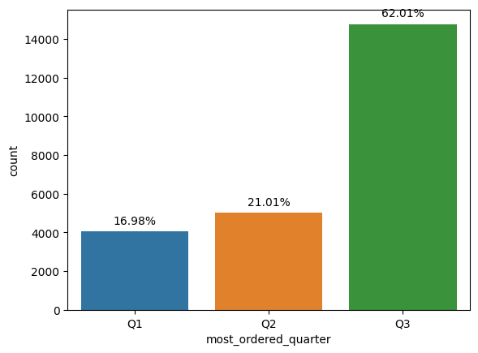
MOST ORDERED QUARTER IS Q3 WHICH IS THE MONTH BETWEEN SEPTEMBER TO DECEMBER WHICH MEANS THE PRODUCT SALES MIGHT BE MOST DURING WINTER PERIOD.
MOST ORDERED QUARTER

Slide 24
Model building
For model building purpose i had used different models such as
1)Naive bayes classifier
2)Decision tree classifier
3)Random forest classifier
4)Svm classifier
5)Ada-boost classifier
6)xgboost classifier
7)neural networks
8)Gradient boosting technique

Slide 25
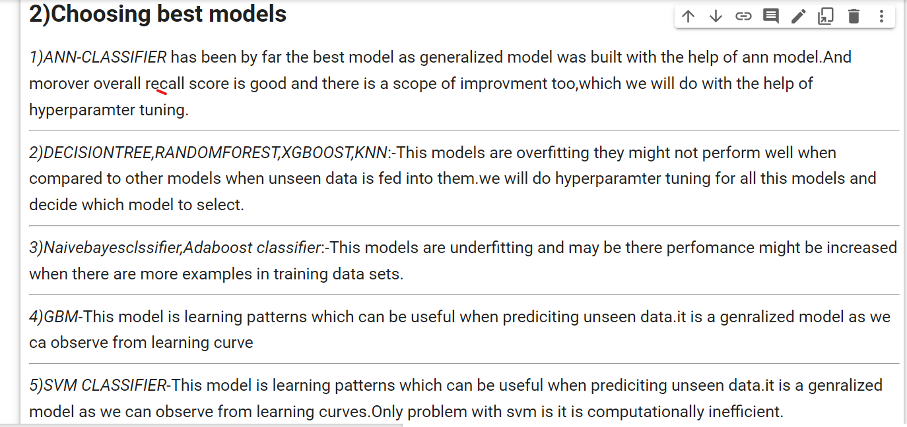
Results from model building
The choice of best model had come from learning curves,classification reports,As for us recall metric is important we will focus more on recall of medium retention potential.In next few slides learning curves will be shown

Slide 26
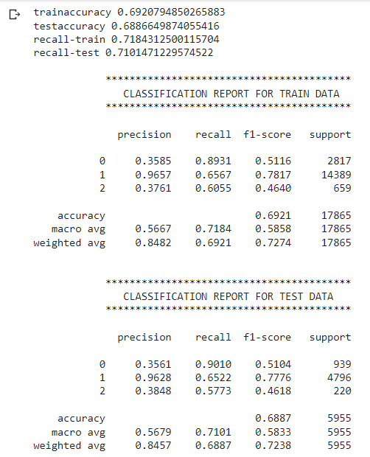
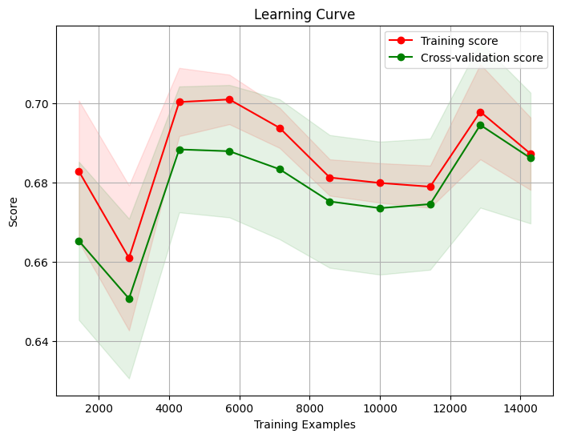
As per observation from learning curve,Naive bayes classifier models seems to underfit.The reason for our model underfitting could be lesser training data,but if we observe classification report we could see that recall for target label is also low.So,we will further decide on checking other models.Here we are not getting desired perfomance.

Slide 27
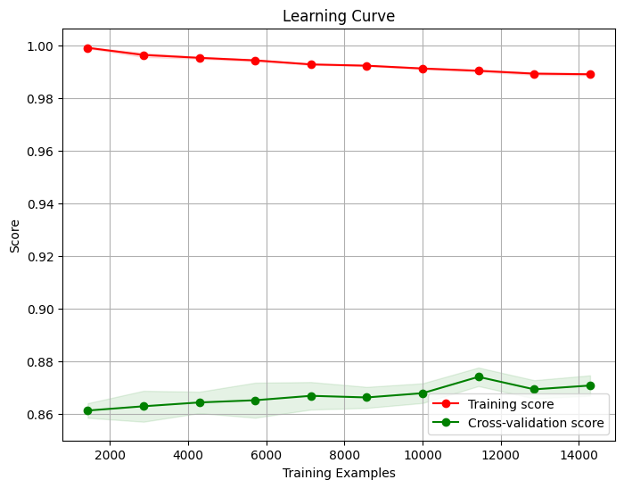

As per observation from our learning curve we could see that model is overfitting.Best models should always generalize well when faced with instances that were not part of the initial training data.There is a large gap between training and validation data.To adress this issue we can either add more data or do hyperparamter tuning for better results.

Slide 28
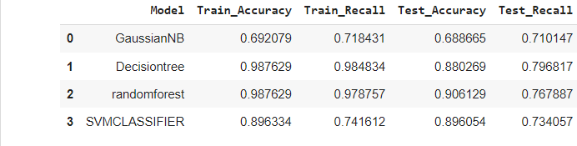
sSVM MODEL HAS GENERALIZED WELL AND FIT INTO OUR DATA BUT ONLY PROBLEM IS THAT FOR HYPER-PARAMETER TUNING IT IS COMPUTATIONALLY INTENSE AND EVEN THOUGH IT FITTED WELL BUT STILL RECALL SCORE IS ON LOWER SIDE SO WE ARE NOT GOING TO KEEP SVM MODEL UNTIL ANY OTHER MODEL IS NOT WORKING.FOR HYPERPARAMETER TUNING WE WOULD STILL PREFER DECISION TREE AS GENERALLY DECISION TREE IS A OVERFITTING MODEL SO WE WILL DO PRUNING FOR IT AND SEARCH FOR DIFFERENT HYPERPARAMETERS.

Slide 29
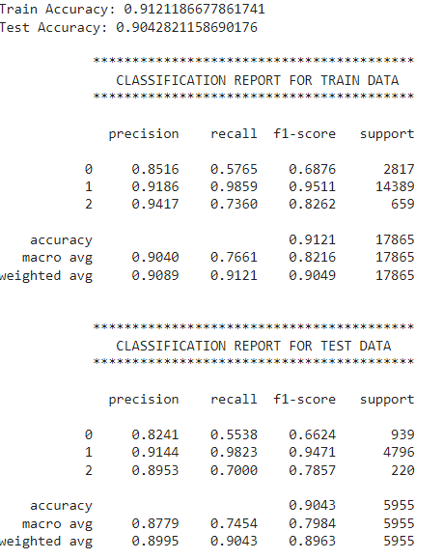
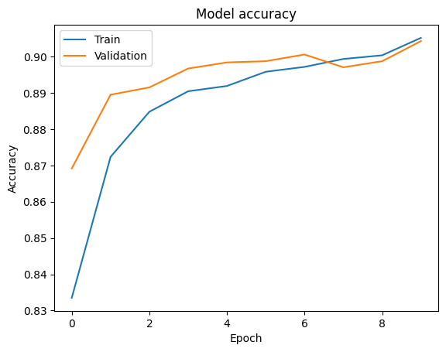
ANN Classification had generalized the date well and had better performance on validation data compared to other models but still recall score of 2 is too less

Slide 30
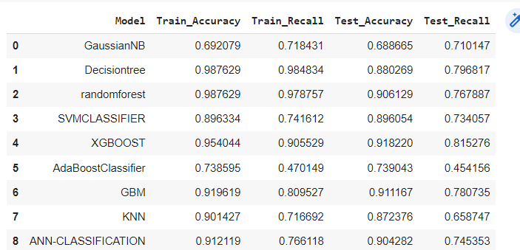
Overview of all models-without smote

Slide 31
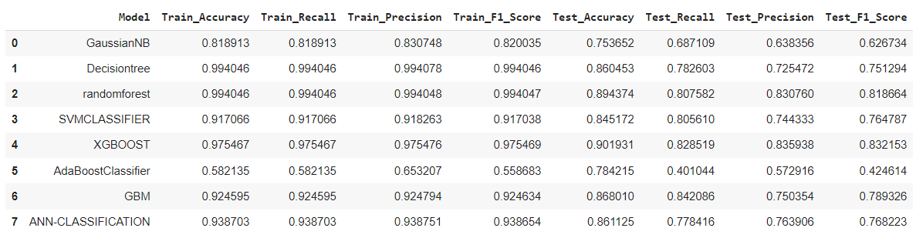
MODELS-WITH SMOTE- ALL the models are overfitting so we will not use smote.As unseen data should be predicted well and our model should generalize well so we will not use smote technique.

Slide 32
After experimenting different models,hyperparameter tuning of decision tree with stratified k fold had given me best results.The results are shown in next slide

Slide 33
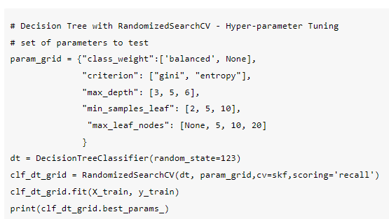

Slide 34
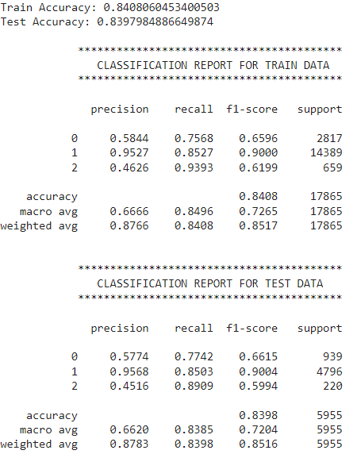
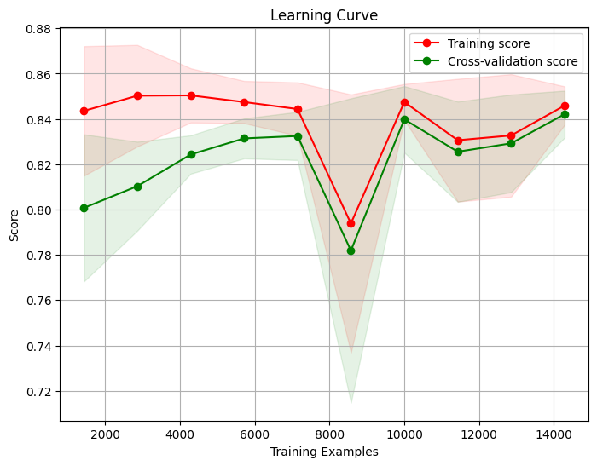
RECALL SCORE OF 0.89

Slide 35
Suggestions to company
1)Services such as online delivery,doorstep delivery should be made cheaper as more customers would be attracted
2)Customer with average orders more than 50 are more for the target medium customers so in order to attract them and be loyal to their product,they should give some benefits to those customers.
3)During off-season from months february to may,customer acquisition should be taken care of because there is less no of transactions during this period so email campaigns should be at their peak level for better performance in winter season.
4)Customers who have long term relation with the company,should be sent emails regularly such that they would be engaged with the business.
5)Feedbacks from the customer should be appreciated and they should be monitored regularly.

Slide 36
Sourcecode:-https://colab.research.google.com/drive/1oVFVKTqhfYENB5ZU3FKKwtW9qQRb3Xdy#scrollTo=jD8xfnOgXUkW

